Slide 1
Chapter 1
.
INTRODUCTION TO AN OPERATING SYSTEM

Slide 2
Chapter Learning Outcomes
After completing this chapter, students will be able to:
Define an operating system
Recognize aim of operating system
Understand different types of operating system
And Advantages and disadvantages of os

Slide 3
.
What is an operating system?
Os has many definitions.
An operating system (OS) is a group of computer programs, including device drivers, kernels, and other software that lets people to interact with a computer.
It is a components of system software which intermediate (interface) between users and computer hardware as well as other software program.
Every computer must have at least one operating system to manages the resources of a computer and run other program.
The purpose of an OS is to provide an environment in which a user can execute programs in a convenient and efficient manner.
It controls the allocation of resources and services such as memory, processors, information and the execution of all kinds of programs.

Slide 4
.
Cont…
A more common definition is an OS is a crucial component of the system software in a computer system and is, that it is a program running at all times on the computer (usually called the kernel), with all else being applications programs.
What is Kernel?
At the heart of an OS is the kernel, which is the lowest level, or core, of the operating system that is the first layer of software loaded into memory when a system boots or starts up.
Kernel provides access to various common core services to all other system and application programs.

Slide 5
Cont…

Slide 6
OS is designed to serve two basic purposes:
It provides an interface between the computer hardware and the programmer that simplifies and makes feasible for creation, coding, debugging of programs.
It controls the allocation and use of the computing system‘s resources among the various user and tasks.

Slide 7
An OS must support the following tasks
Provides the facilities to create, modification of program and data files using editor.
Access to the compiler for translating the user program from high level language to machine language.
Provide a loader program to move the compiled program code to the computer ‘s memory for execution.
Provide routines that handle the details of I/O programming.

Slide 8
The basic purposes of OS
Process Management
What is process? A program in execution is mentioned as a process and it is a key concept in all OS.
A program does nothing unless its instructions are executed by a CPU. This process needs certain resources- including CPU time, memory and I/O devices to accomplish its task.
These resources are either allocated to process while it is running or deallocated while it is not running. So, this is responsibility of OS that is called process management.

Slide 9
Cont…
The OS is responsible for the following activities in connection with process management:
Creating and deleting both user and system processes.
Suspending and resuming processes.
Providing mechanisms for process synchronization.
Providing mechanisms for process communication.

Slide 10
Memory Management
Memory management refers to management of Primary Memory or Main Memory.
Main memory is a large array of words or bytes where each word or byte has its own address.
Memory management module performs the task of allocation and de-allocation of memory space to programs in need of this resources.
In a very simple OS, only one program at a time is in the memory. To run second program, the first one has to be removed and the second one placed in memory. Single Tasking system.
More sophisticated Os allow multiple programs to be in memory at the same time. To keep them from interfering with one another, OS provides some kind of protection mechanism. Multi-Tasking system.

Slide 11
Cont…
OS is responsible for the following activities in connection with memory management:
Keeps tracks of primary memory i.e. what part of it are in use by whom, what part are not in use.
Deciding which processes and data to move into and out of memory,
Allocating and de-allocating memory space as needed.

Slide 12
File Management
File is a collection of data that can be mentioned by name and stores the instructions that are executed for that process to run.
It manages all the file-related activities such as organization storage, retrieval, naming, sharing, and protection of files.
There are different types of files includes a text document, a program written in a programming language, image and a directory.
File attributes include the file name, a file type, protection codes, accounting information and etc.
We may also read, write and finally, we need to close the file, indicating that we are no longer using it.
So, these all facilities are provided and controlled by OS which is called file management.

Slide 13
Cont…
The OS is responsible for the following activities in connection with file management:
Creating and deleting files,
Creating and deleting directories that is used to organize files
Mapping files onto secondary storage media.
Backing up files on stable (nonvolatile) storage media.

Slide 14
Resource Management
Different types of resources are managed by the OS. When there are multiple users or multiple jobs running at the same time, resources must be allocated to each of them. It performs the task of allocation and de-allocation of the devices.
In case of multi-user or multi-tasking environment, resources such as main memory, CPU cycles and files storage are to be allocated to each user or job.
Major activities of an operating system with respect to resource management.
OS manages all kind of resources using schedulers.
CPU scheduling algorithms are used for better utilization of CPU.

Slide 15
Types of Operating System
The Followings are some important types of OS most commonly used.
Batch Operating System
Multiprocessor Operating System
Time-sharing operating systems
Distributed operating System
Network operating System
Real Time operating System

Slide 16
Batch operating system
Batch processing is very popular in which the jobs are executed in batches.
Under batch processing, the data is collected before any processing can take place and then entered into the system in one go (a batch of data) and processed.
Therefore, Batch processing is when the computer does not carry out any processing and does not produce any output until all the inputs have been collected.
The users of a batch operating system do not interact with the computer directly while it’s running or working on a job.

Slide 17
Cont…
Each user prepares his job on an off-line device and submits it to the computer operator.
computer operator takes similar jobs having same requirement and group them into batches.
To speed up processing, jobs with similar needs are batched together and run as a group.
So, an operator sort the jobs with similar needs and put batch of the jobs on an input device.
No input in the middle of the process and also no output either.
So, the batch operating systems were designed to speed up the process by grouping jobs those are similar in nature into one job and execute them as a group and then send back output of each jobs to its programmer.

Slide 18
2.Multiprocessor Operating System
A Multiprocessor operating system consists of several processors that share a common physical memory.
It provides higher computing power and speed. In multiprocessor system all processors operate under single operating system.
Multiplicity of the processors and how they do together are transparent to the others by operating system.
In Multiprocessing, Parallel computing is achieved. which can execute more than one process at the same time.
This will increase the throughput of the system.
Multiprocessing operating system is more complex and sophisticated as it takes care of multiple CPUs simultaneously.

Slide 19
Advantages of Multiprocessing operating system
Increased reliability:
In multiprocessing system, processing tasks can be distributed among several processors. This increases reliability as if one processor fails, the task can be given to another processor for completion.
Increased throughout: As several processors increase, more work can be done in less.
Disadvantages of Multiprocessing operating System
Multiprocessing operating system is more complex and sophisticated as it takes care of multiple CPUs simultaneously.

Slide 20
3.Time-sharing /Multitasking OS
Time sharing is a technique that enables many people, located at various terminals, to use a particular computer system at the same time.
Processor's time which is shared among multiple users simultaneously is termed as time-sharing.
Multiple jobs are executed by the CPU by switching between them, but the switches occur so frequently and the user can receive an immediate response.
The time that each task gets to execute is called quantum. These systems are also known as Multitasking Systems.
Time-Sharing Systems objective is to minimize response time.

Slide 21
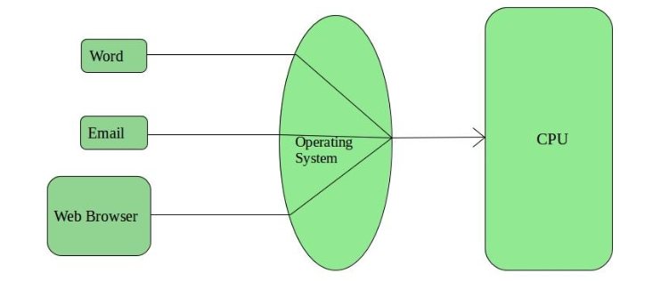
Cont…

Slide 22
Advantages of Timesharing operating systems
Provide quick response.
Each task gets an equal opportunity
CPU idle time can be reduced
Disadvantages of Timesharing
Problem of reliability.
Question of security and integrity of user programs and data.
Problem of data communication.

Slide 23
4.Distributed operating System
Distributed systems use many processors located in different machines to provide very fast computation to its users.
Numerous autonomous interconnected computers communicate each other using a shared communication network or network middleware.
Independent systems possess their own memory unit and CPU. These are referred as loosely coupled systems.
The major benefit of working with these types of operating system is that it is always possible that one user can access the files or software which are not actually present on his system but on some other system connected within this network.
Distributed systems use multiple central processors and Data processing jobs are distributed among the processors.
The processors communicate with one another through various communication lines (such as high-speed buses or telephone lines).

Slide 24
Advantages of distributed systems
With resource sharing facility user at one site may be able to use the resources available at another.
If one site fails in a distributed system, the remaining sites can potentially continue operating.
Better service to the customers.
Reduction of the load on the host computer.
Reduction of delays in data processing.

Slide 25
Disadvantages of Distributed Operating System:
Failure of the main network will stop the entire communication.
It is difficult to provide adequate security in distributed systems because the nodes as well as the connections need to be secured.
Some messages and data can be lost in the network while moving from one node to another.
These types of systems are not freely available as they are very expensive.

Slide 26
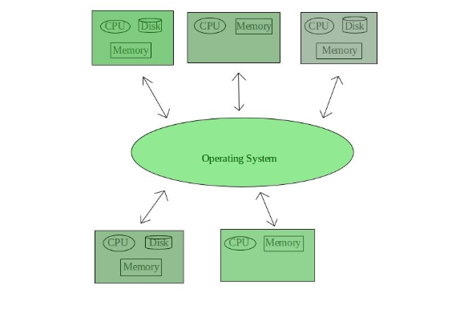
Cont…

Slide 27
5.Network operating System
Network Operating System runs on a server and provides server the capability to manage data, users, groups, security, applications, and other networking functions.
The primary purpose of the network operating system is to allow shared file and printer access among multiple computers in a network.
Examples of network operating systems are Microsoft Windows Server 2003, Microsoft Windows Server 2008, UNIX, Linux, Mac OS X, Novell NetWare, and BSD.

Slide 28
The advantages of network operating systems
Centralized servers are highly stable.
Security is server managed.
Upgrades to new technologies and hardware can be easily integrated into the system.
Remote access to servers is possible from different locations and types of systems.
Disadvantages are:-
High cost of buying and running a server.
Dependency on a central location for most operations.
Regular maintenance and updates are required.

Slide 29
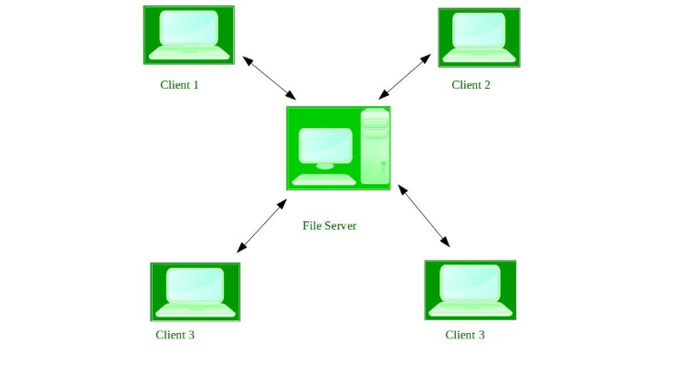
Cont…

Slide 30
6.Real Time operating System
Real time system is defined as a data processing system in which the time interval required to process and respond to inputs is so small that it controls the environment.
The time taken by the system to respond to an input and display of required updated information is termed as response time.
So, in this method response time is very less as compared to the online processing.
Real time processing is always on line whereas on line system need not be real time.
Examples of Real-Time Operating Systems are: Scientific experiments, medical imaging systems, industrial control systems, weapon systems, robots, air traffic control systems, etc.
There are two types of real-time operating systems.

Slide 31
Hard real-time and Soft real-time systems
Hard real-time operating systems
Hard real-time systems also called immediate real-time system guarantee that critical tasks complete on time.
Hard real time systems uses preemptive version of priority scheduling, so that critical tasks get immediately scheduled. Hard real-time means you must absolutely hit every deadline.
Soft real time operating systems
It is less restrictive than hard real time and Critical real-time task gets priority over other tasks and retains the priority until it completes.
Soft real time systems uses non-preemptive version of the priority scheduling, which allows the present task to be finished before control is transferred to the higher priority task and can miss some deadlines, but eventually performance will degrade if too many are missed.

Slide 32
Advantages of RTOS:
Maximum utilization of devices and system, thus more output from all the resources.
Task Shifting: Time assigned for shifting tasks in these systems are very less.
For example in older systems it takes about 10 micro seconds in shifting one task to another and in latest systems it takes 3 micro seconds.
Error Free: These types of systems are error free.
Memory Allocation: Memory allocation is best managed in these type of systems.

Slide 33
Disadvantages of RTOS:
Limited Tasks: Very few tasks run at the same time and their concentration is very less on few applications to avoid errors.
Use heavy system resources: Sometimes the system resources are not so good and they are expensive as well.
Complex Algorithms: The algorithms are very complex and difficult for the designer to write on.
Device driver and interrupt signals: It needs specific device drivers and interrupt signals to response earliest to interrupts.
Thread Priority: It is not good to set thread priority as these systems are very less prone to switching tasks.

Slide 34

THE END
QUESTION?
COMMENT

